Slide 1

Unlocking Insights: Analyzing Amazon Sales Data

Slide 2

Introduction
The project "Exploring Amazon Sales Data" aims to analyze and derive insights from historical sales data obtained from Amazon. With the exponential growth of e-commerce platforms like Amazon, understanding sales trends and customer preferences becomes crucial for businesses to make informed decisions regarding product offerings, marketing strategies, and inventory management. By leveraging data analysis techniques, this project seeks to uncover valuable insights that can drive business growth and improve decision-making processes.

Slide 3
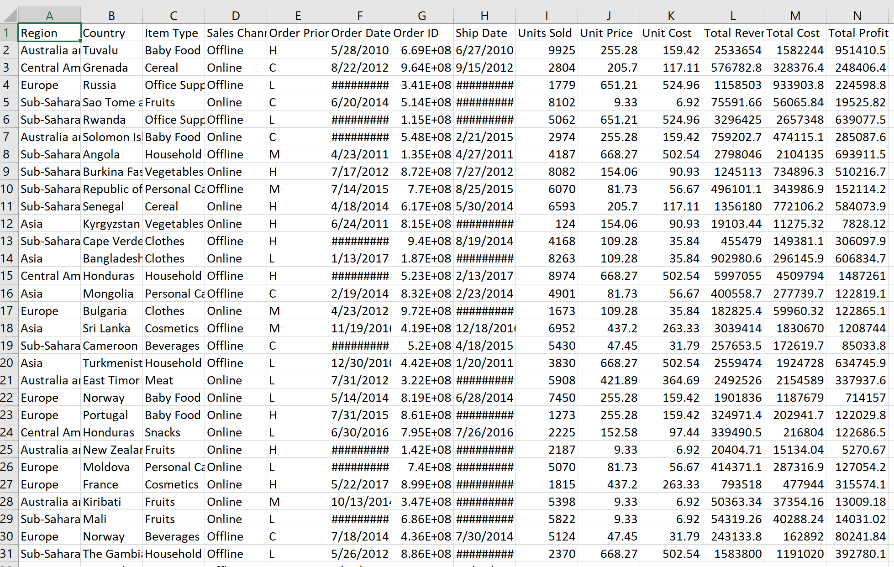
Sales Data Overview
The project begins with the collection of historical sales-data from Amazon, encompassing various product categories, sales regions, and time periods. The dataset contains information such as product IDs, sales quantities, prices, timestamps, and customer demographics.
Initial data quality assessment and cleaning procedures are conducted to ensure the reliability and accuracy of the dataset, including handling missing values, outliers, and inconsistencies.

Slide 4
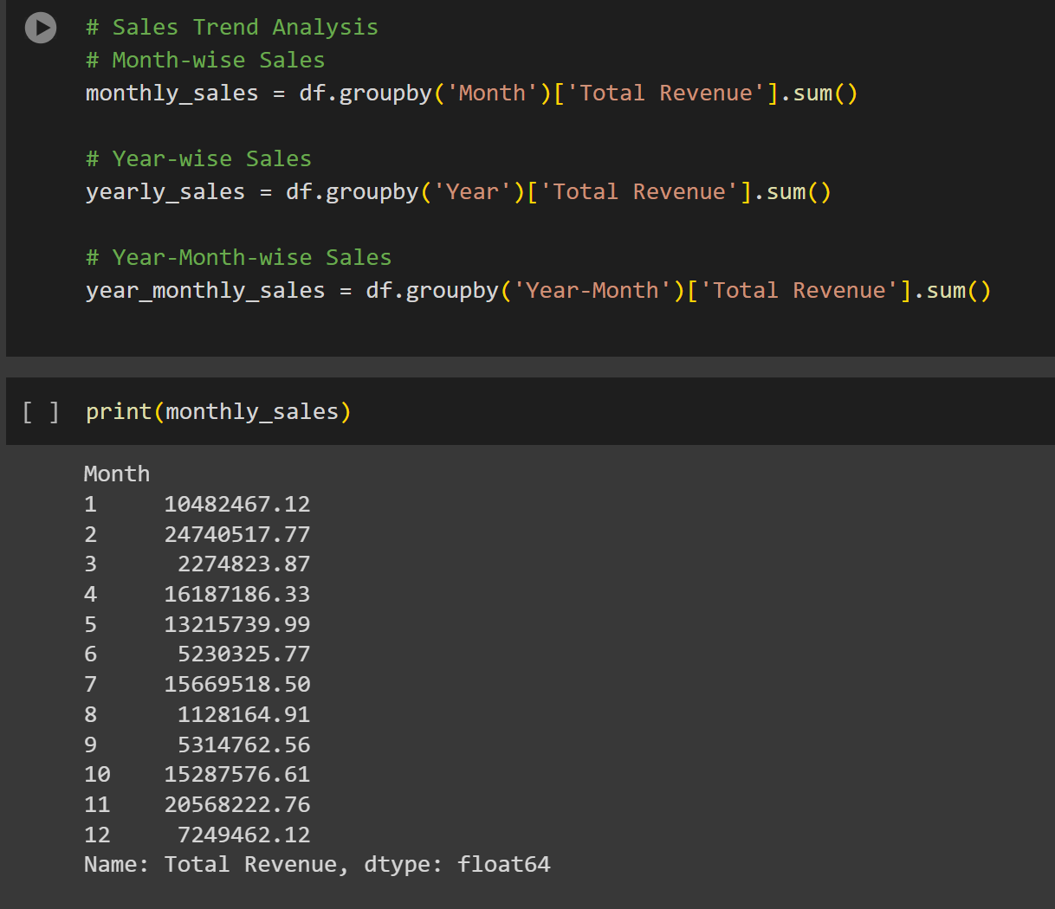
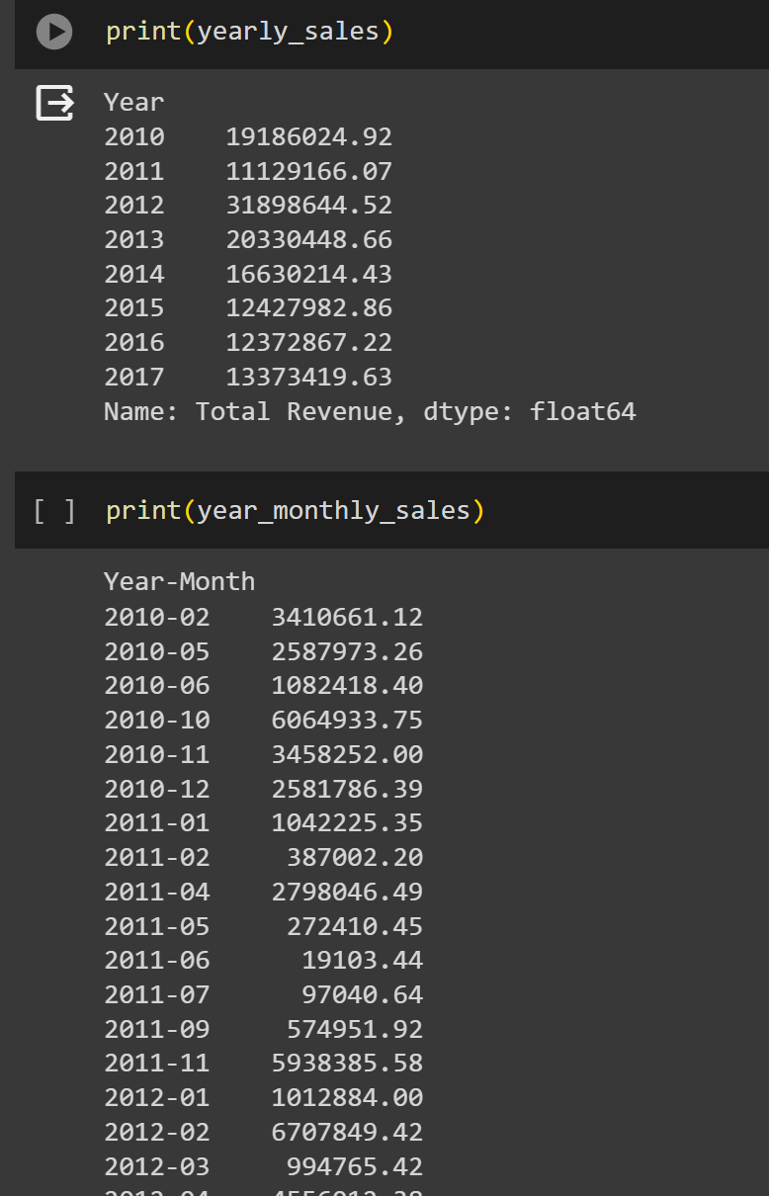
Sales Trends Analysis in Python
The sales trend analysis delves into the historical sales data to identify patterns, seasonal variations, and trends over time. Leveraging the dataset obtained from Amazon, the analysis begins with exploratory data analysis (EDA) to understand the distribution of sales across different time periods, product categories, and regions. The following steps outline the sales trend analysis process based on the provided Google Colab code:
Product Category Analysis:
The dataset is analyzed to understand sales trends across different product categories. This involves aggregating sales data by product category and visualizing the sales performance of each category over time.
Bar charts or stacked area charts can be used to compare the sales volume or revenue generated by each product category, highlighting the best-performing categories and identifying potential opportunities for growth.
Regional Sales Analysis:
Geographical sales analysis is conducted to identify regional variations and preferences. The dataset is segmented based on sales regions or locations, and sales trends are analyzed for each region.
Regional sales maps or heatmaps can be created to visualize the distribution of sales across different geographic areas, highlighting regions with high or low sales volumes.

Slide 5
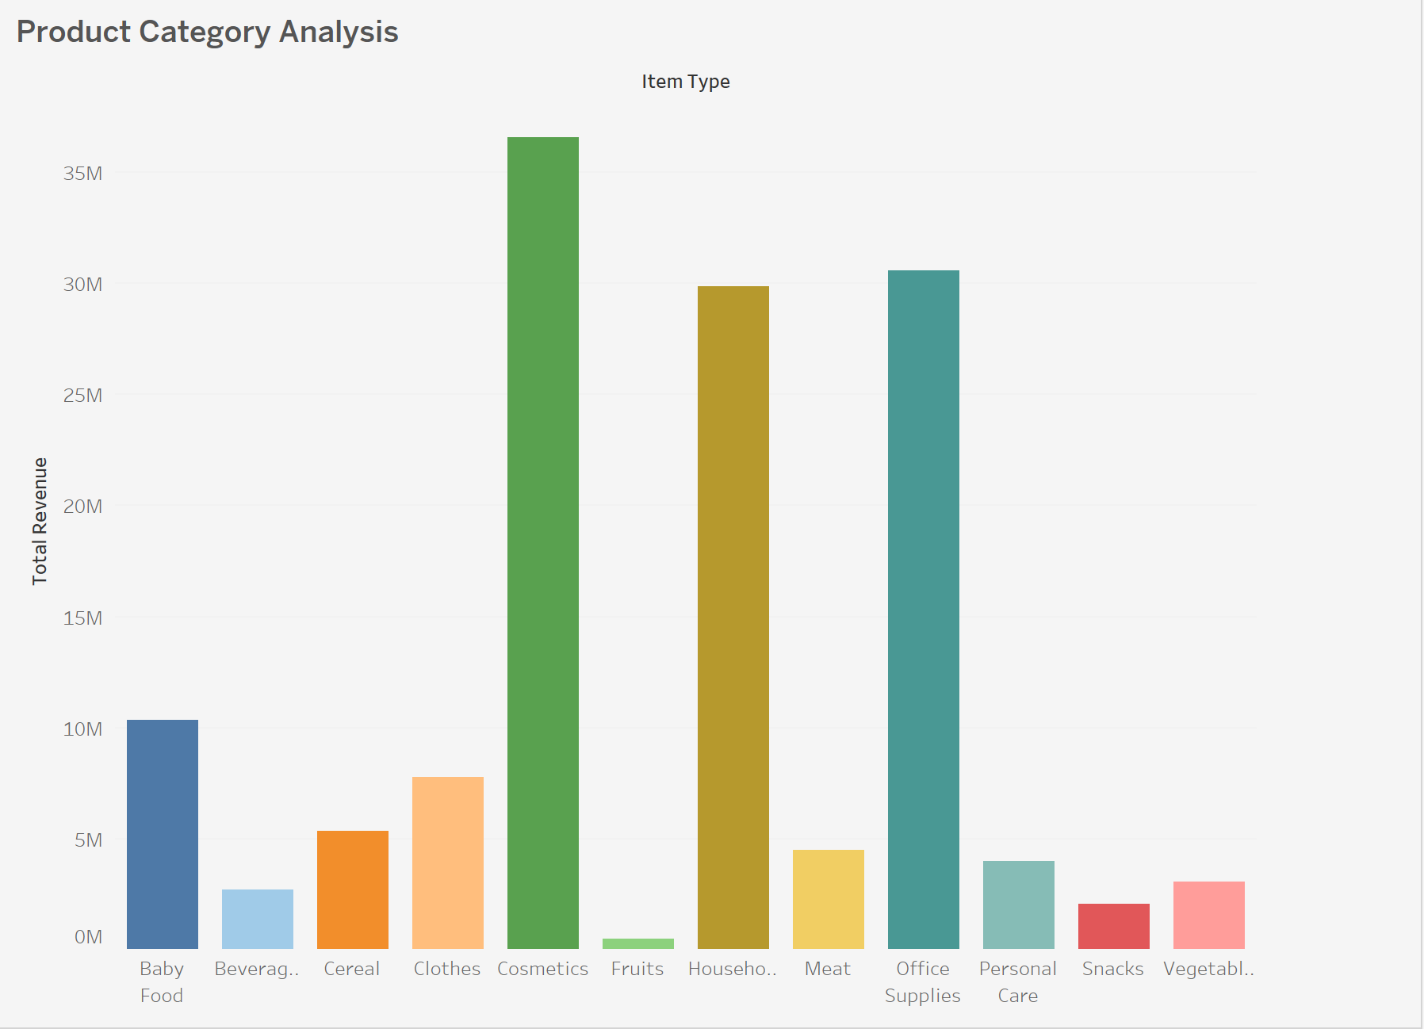
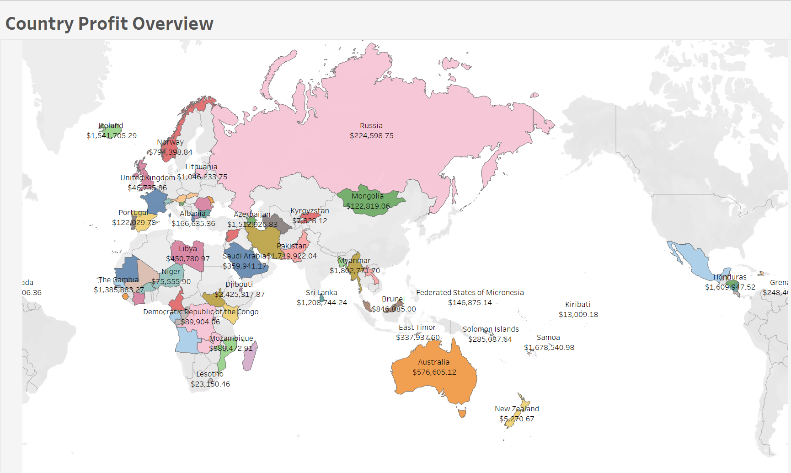
Data Visualization
To facilitate the interpretation of sales data and trends, various data visualization techniques are employed. Visualizations include line charts to illustrate sales trends over time, bar charts to compare sales across different product categories or regions, and heatmaps to identify peak sales periods. Scatter plots and regression analysis may also be used to explore correlations between sales performance and other variables such as pricing or marketing efforts.

Slide 6
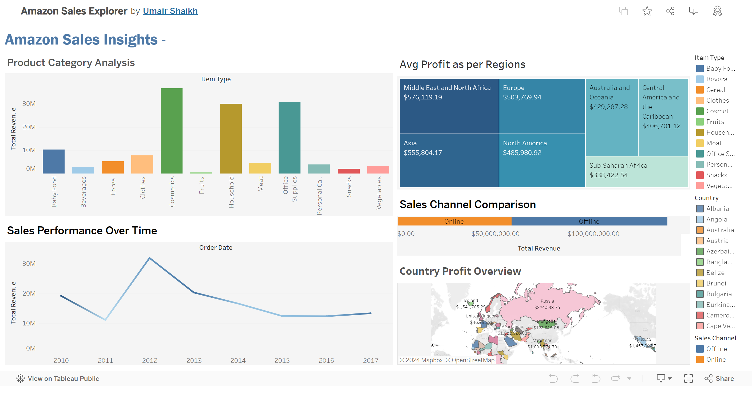
Dashboard

Slide 7
Conclusion
Analyzing Amazon sales data provides a wealth of insights that can drive business growth and enhance sales performance. By leveraging data analytics, we can gain a deeper understanding of customer behavior and market trends, ultimately optimizing our sales strategy to stay ahead in the competitive e-commerce landscape.

Slide 8
Thanks!
Do you have any questions? Umair.shaikh0214@gmail.com

